Slide 1
Lecture 9
Functions

Slide 2
Announcements

Slide 3
Review: charts
Scatter plot: relation between numerical variables
Line graph: sequential data (over time, etc.)
Bar chart: distribution of categorical data
Histogram: distribution of numerical data

Slide 4
Histogram Axes
By default, hist uses a scale (normed=True) that ensures the area of the chart sums to 100%
The area of each bar is a percentage of the whole
The horizontal axis is a number line (e.g., years), and the bins sizes don’t have to be equal to each other
The vertical axis is a density (e.g., percent per year)
(Demo)

Slide 5
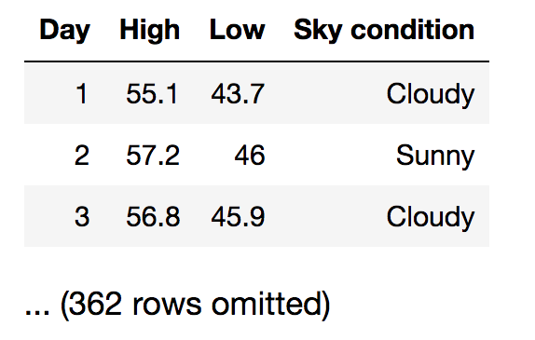
Discussion Question
You have data about daily temperatures as shown. Which type of chart would you use to answer each question?
Are there more cloudy than sunny days?
What percentage of days have a high above 72º?
Did many days have a difference of more than 20 degrees between their high & low temperatures?

Slide 6
Defining Functions

Slide 7
Def Statements
User-defined functions give names to blocks of code
Name
Argument names (parameters)
def spread(values):
return max(values) - min(values)
Return expression
Body
(Demo)

Slide 8
Discussion Question
What does this function do? What kind of input does it take? What output will it give? What's a reasonable name?
def f(s):
return np.round(s / sum(s) * 100, 2)
(Demo)

Slide 9
Apply

Slide 10
Apply
The apply method creates an array by calling a function on every element in input column(s)
First argument: Function to apply
Other arguments: The input column(s)
table_name.apply(function_name, 'column_label')
(Demo)

Slide 11
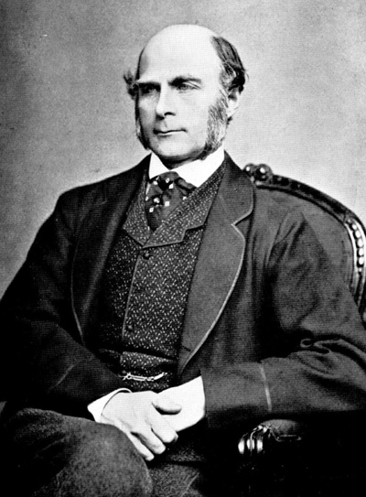
Sir Francis Galton
1822 - 1911 (knighted in 1909)
A pioneer in making predictions
Particular (and troublesome) interest in heredity
Charles Darwin's half-cousin
(Demo)

